Slide 1

Agenda
Work Management
IT Service Management
Agile and DevOps
Atlassian is mainly known for JIRA, the project management tool founded in 2002.
We’ll know about other Atlassian products here.

Slide 2
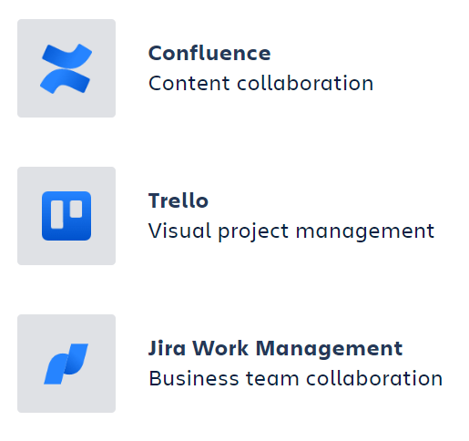
WORK MANAGEMENT
Ones I've used
Notes:
There’re packages to visualize geospatial data like folium etc.

Slide 3

It service management
Services, Operations & Support
Notes:
There’re packages to visualize geospatial data like folium etc.

Slide 4
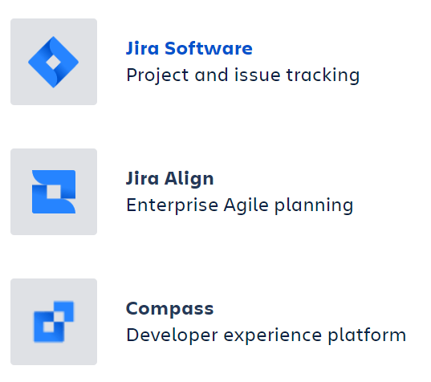
AGILE & DEVOPS
Ones I've used

Slide 5
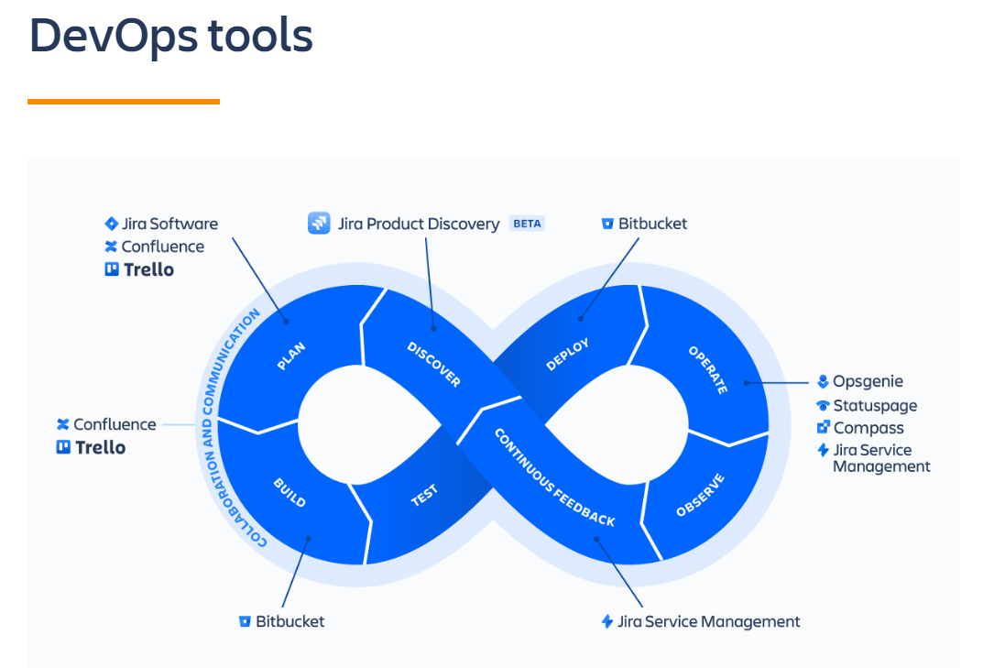
Devops lifecycle
What is DevOps? | Atlassian

